Slide 1

HR Analytics:
Reducing Attrition Through Data-Driven Insights
Arunava Maiti

Slide 2
Introduction
Employees are the backbone of the organization. Organization's performance heavily depends on the quality of the employees. Challenges that an organization has to face due employee attrition are:
Expensive in terms of both money and time to train new employees.
Loss of experienced employees
Impact in productivity
4.Impact profit This project selects this topic and dataset for the purpose of : Discover the factors that affect employee attrition and then take measures to reduce this rate. Build a machine learning model based on employee factors to predict whether that employee is likely to attrition or not?
Hiring and retaining employees are extremely complex tasks that require capital, time and skills.
“Small business owners spend 40% of their working hours on tasks that do not generate any income such as hiring”.
“Companies spend 15%-20% of the employee's salary to recruit a new candidate”.
“An average company loses anywhere between 1% and 2.5% of their total revenue on the time it takes to bring a new hire up to speed”.
Hiring a new employee costs an average of $7645 (0-500 corporation).
It takes 52 days on average to fill a position.
Source: https://toggl.com/blog/cost-of-hiring-an-employee

Slide 3
Business Problem
Employee attrition, or turnover, is a critical problem for organizations, as hiring and training new employees costs significant time and resources. High attrition rates can lead to decreased productivity, increased expenses, and a loss of organizational knowledge. The goal is to identify factors influencing employee attrition and build a machine learning model to predict whether an employee is likely to leave the company.
Employee attrition refers to employees leaving a company.
Predicting attrition helps in workforce planning and retention strategies.
Machine learning models can analyze employee data to predict attrition.

Slide 4
Objective: Predict and prevent employee attrition.
Attrition Risk Dashboard: The HR team can access a dashboard showing employees ranked by their attrition risk scores, enabling proactive interventions.
Retention Strategies: Based on predictions, HR can:
Offer tailored incentives to high-risk employees (e.g., salary adjustments, flexible work schedules).
Address dissatisfaction through counseling or team-building activities.
Identify bottlenecks in work-life balance and job satisfaction.
Value to the Organization
Cost Savings: By retaining employees, reduce hiring costs and training costs.
Improved Productivity: Keep experienced employees who contribute more efficiently to organizational goals.
Reduced Hiring Time: Proactively retain employees and decrease the need to fill positions that take an average of 52 days to fill.
Enhanced Employee Experience: Create a supportive environment where employees feel valued and motivated.
This predictive model can transform how HR handles employee retention, saving both time and resources while fostering a more satisfied and stable workforce.

Slide 5
Dataset: Human Resources Employee Data
Key Features: Age, Monthly Income, Job Role, Distance From Home, etc.
Target Variable: Attrition (0 = Stayed, 1 = Left)
Data Source: CSV file loaded in Google Colab
Data Source: https://www.kaggle.com/pavansubhasht/ibm-hr-analytics-attrition-dataset
code repository : https://github.com/arunavamaiti/dshr
Dataset Overview

Slide 6
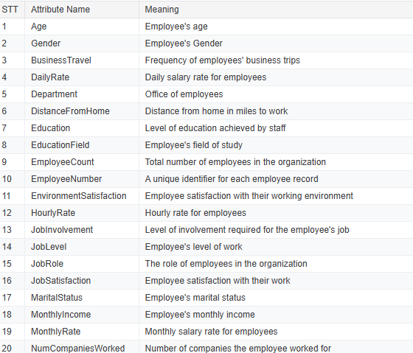
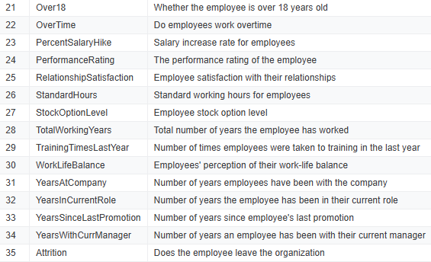
Sample Attributes

Slide 7
Data Preprocessing
Handling Missing Data:
Checked for missing values using a heatmap (Seaborn) and found no missing data.
Feature Selection:
Dropped unnecessary features (EmployeeNumber, Over18, StandardHours) as they provide no predictive value.
Encoding Categorical Variables:
Applied One-Hot Encoding to categorical features (JobRole, Department, MaritalStatus, etc.).
Feature Scaling:
Used MinMaxScaler to scale numerical features for better model performance.

Slide 8
Exploratory Data Analysis (EDA)
Purpose of EDA:
Understand data distribution and relationships between variables.
Identify key trends and factors influencing attrition.
Key Insights from Data:
Younger employees tend to leave more frequently.
Employees with lower job levels and salaries are more likely to leave.
Sales representatives have higher attrition rates compared to other job roles.
Employees who live farther from work tend to leave more often.
Single employees have a higher likelihood of leaving compared to married or divorced employees.
Visualizations Used:
Heatmap: Shows correlation between numerical features.
Countplots: Displays categorical feature distributions (e.g., Attrition by Job Role, Marital Status, and Age).
Kernel Density Estimation (KDE) Plots: Analyzes probability distribution of attrition based on factors like Distance From Home and Total Working Years.
Boxplots: Compares salary distributions across different job roles and gender.
EDA Conclusion:
Factors like Age, Monthly Income, Job Role, and Distance From Home significantly influence attrition.
Identifying high-risk employees helps in retention strategies

Slide 9
Model Selection
Logistic Regression: A simple and interpretable model for binary classification, suitable for understanding feature importance.
Random Forest Classifier: A powerful ensemble model that reduces overfitting and improves accuracy by using multiple decision trees.
Artificial Neural Network (ANN): A deep learning model capable of capturing complex relationships in data for improved predictions.
Why These Three Models?
Logistic Regression: Provides a baseline model that is easy to interpret and quick to train.
Random Forest: Offers a balance between interpretability and predictive power, leveraging multiple trees to reduce variance.
ANN: Captures complex patterns in data, making it ideal for high-dimensional datasets.
Decision Criteria:
Evaluated based on accuracy, precision, recall, and F1-score.
Considered interpretability, training time, and computational efficiency.
Training Approach:
Used train_test_split with a 75%-25% split.
Implemented cross-validation to enhance model robustness.
Applied hyperparameter tuning for optimal performance.

Slide 10
Hyperparameter Tuning for ANN
Used Keras-Tuner to find the best combination of layers, neurons, activation functions, and optimization techniques.
Hyperparameter Optimization Process:
Tuned number of hidden layers, neurons per layer, batch size, and learning rate.
Evaluated multiple optimizers (Adam, RMSprop, SGD) to find the best performance.
Conducted trials with different dropout rates to prevent overfitting.
Best Parameters Identified:
Layers: 3 Hidden Layers
Neurons per Layer: 500, 250, 100 (Progressively decreasing for better feature extraction)
Activation Function: ReLU for hidden layers, Sigmoid for output layer
Optimizer: Adam (selected for its adaptive learning rate benefits)
Loss Function: Binary Cross-Entropy
Batch Size: 32 (balanced performance and computational efficiency)
Learning Rate: 0.001 (achieved the best convergence without overfitting)

Slide 11
Model Evaluation & Comparison
Logistic Regression | Random Forest Classifier | Artificial Neural Network (ANN)
Pros:
Simple and interpretable.
Fast to train and requires fewer computational resources.
Provides probability estimates for attrition.
Works well when features are linearly separable.
Cons:
Limited in capturing complex patterns in the data.
May not perform well on high-dimensional or highly non-linear datasets.
Struggles with imbalanced data.
Evaluation:
Accuracy is likely moderate but may not be the best compared to more complex models.
Confusion matrix and classification report should be checked for precision, recall, and F1-score.
When to Use?
If interpretability is important (i.e., HR wants clear insights into attrition factors).
When you need a quick and simple baseline model.
Pros:
Handles both linear and non-linear relationships well.
Robust to outliers and missing values.
Can handle imbalanced datasets better than logistic regression.
Feature importance analysis helps in understanding key predictors of attrition.
Cons:
Computationally expensive, especially with large datasets.
Harder to interpret compared to logistic regression.
Can overfit if not properly tuned.
Evaluation:
Likely better accuracy than logistic regression.
The confusion matrix should show fewer false negatives.
Feature importance analysis helps identify key factors affecting attrition.
When to Use?
If you need a more powerful, flexible model than logistic regression.
If feature importance is useful for decision-making.
Pros:
Captures complex patterns and non-linear relationships.
Can generalize well if trained correctly.
Works well with large datasets.
Cons:
Computationally expensive and requires hyperparameter tuning.
Requires large training data to avoid overfitting.
Harder to interpret compared to decision trees and logistic regression.
Evaluation:
Likely best accuracy if trained well.
Can overfit if the dataset is small or unbalanced.
Requires hyperparameter tuning for best results.
When to Use?
If maximizing prediction accuracy is the top priority.
If HR is okay with a black-box model (less interpretability).
If enough data is available to prevent overfitting

Slide 12
Model Evaluation & Comparison
Model Comparison Summary
Model | Accuracy | Complexity | Interpretability | Handling Imbalanced Data | Computational Cost
Logistic Regression | Moderate | Low | High | Poor | Low
Random Forest | High | Medium | Medium | Good | Medium
ANN | Very High | High | Low | Good (if tuned) | High

Slide 13
Model Evaluation & Comparison
Metrics Used: Accuracy, Precision, Recall, F1-Score.
Results:
Logistic Regression: ~86% Accuracy.
Random Forest: ~85% Accuracy.
ANN: ~89% Accuracy (Best Model).
Confusion matrix and classification report used for evaluation.
Final Recommendation: If you need the best prediction model → ANN with proper tuning.
If you need interpretability and good performance → Random Forest.
If you want a simple model for quick insights → Logistic Regression

Slide 14
Model Deployment (Flask API)
Steps for Deployment:
Save trained model (.h5 file for ANN).
Create a Flask API to serve predictions.
Expose an endpoint (/predict) to receive employee data and return predictions.
Deploy and test API on Google Colab.

Slide 15
Conclusion
Machine learning models effectively predict employee attrition.
ANN outperformed other models in accuracy.
Deployment via Flask API enables real-time predictions.
Further improvements can enhance prediction accuracy.

Slide 16
Q&A
Thank You!
Any Questions?

